Slide 1
RESEARCH PROJECT REPORT IN FULFILMENT OF SUMMER INTERNSHIP PROJECT
TOPIC:
CHECK SUM DIGIT IN GSTIN
SUBMITTED BY: SUBMITTED TO:
Saniya Usmani Shashwat Singhal

Slide 2
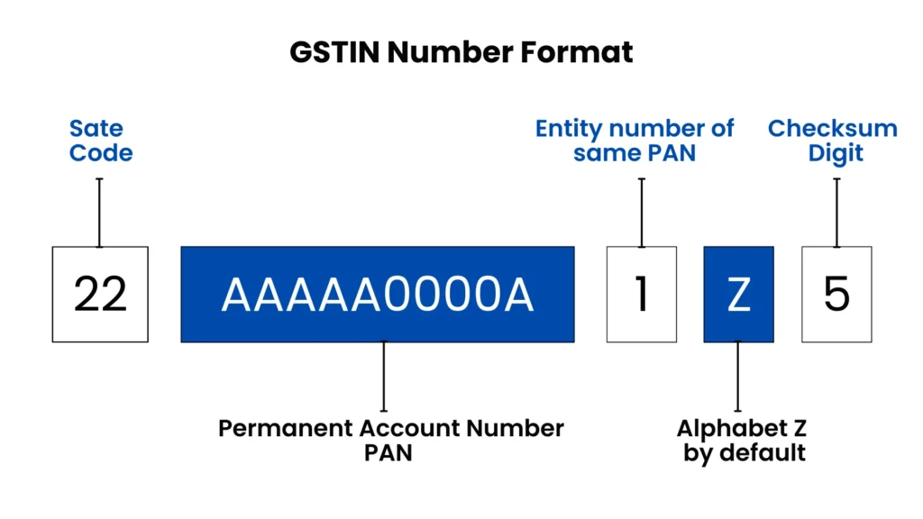
What is a Checksum Digit?
A digit used to validate data accuracy.
Helps detect typing and data-entry errors.
Automatically generated from the preceding 14 characters.
Acts as a verification mechanism.

Slide 3

Why is the GSTIN Checksum Important?
Prevents invalid GSTIN entries.
Improves data integrity.
Reduces processing errors.
Helps government systems verify GSTIN authenticity.

Slide 4

Checksum Calculation Process
Convert each character into a numeric value.
Apply position-based weights.
Multiply values by weights.
Sum the results.
Compute modulus value.
Generate the checksum character.

Slide 5
Step by step Process of Checksum Digit Generation in GSTIN
The 15th character of a GSTIN is the checksum digit. It is generated from the first 14 characters using a mathematical algorithm based on modulo-36 arithmetic.
Step 1: Take the First 14 Characters
Example:
22ABCDE1234F1Z
These 14 characters are used to generate the checksum digit.

Slide 6
Step 2: Assign Values to Characters
GSTIN uses the character set:
0–9, A–Z
Character | Value
0–9 | 0–9
A | 10
B | 11
C | 12
... | ...
Z | 35

Slide 7
Step 3: Apply Alternating Weights
Starting from the left, multiply each character value by alternating weights:
1, 2, 1, 2, 1, 2 ...
Example:
Character | Value | Weight
2 | 2 | 1
2 | 2 | 2
A | 10 | 1
B | 11 | 2
... | ... | ...

Slide 8
Step 4: Calculate Weighted Sum
For each multiplication:
If the product is less than 36, use it directly.
If the product is 36 or greater, divide by 36 and add the quotient and remainder.
Example:
11 × 2 = 22 → use 22
20 × 2 = 40 → quotient = 1, remainder = 4 → use 1 + 4 = 5
Add all resulting values to obtain the total sum.

Slide 9
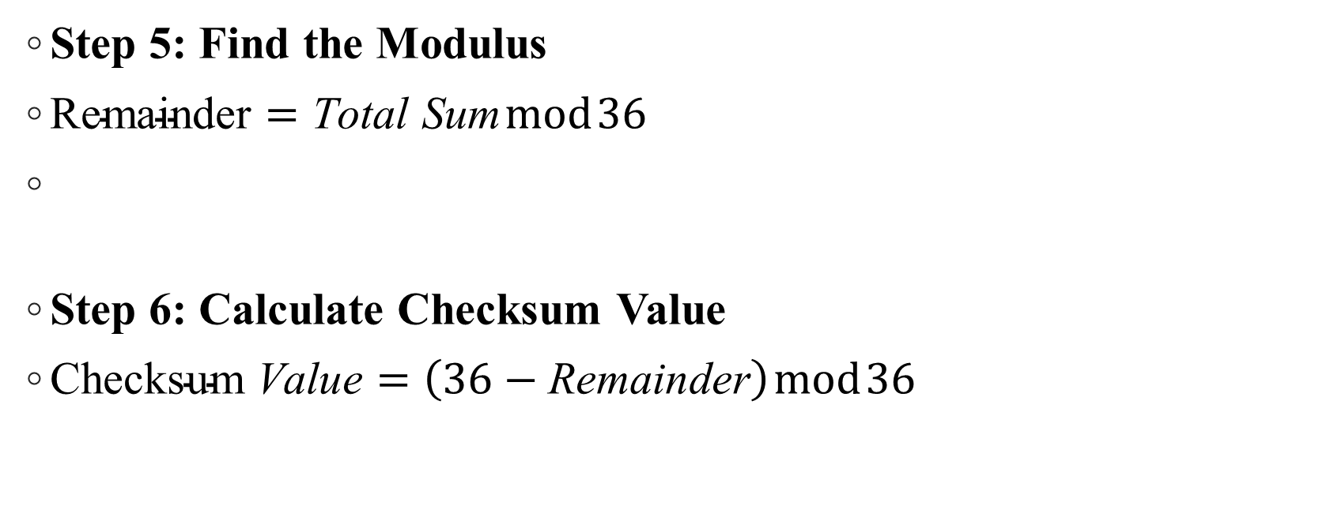
Step 5: Find the Modulus
$\text{Remainder}=\text{Total} \text{Sum} mod 36$
Step 6: Calculate Checksum Value
$\text{Checksum} \text{Value}=\left(36−\text{Remainder}\right) mod 36$

Slide 10
Step 7: Convert Back to Character
Convert the checksum value to its corresponding character:
0–9 → digits 0–9
10–35 → letters A–Z
This character becomes the 15th digit of the GSTIN.

Slide 11
FLOW CHART
First 14 GSTIN Characters
↓
Convert Characters to Values (0–35)
↓
Apply Weights (1, 2, 1, 2...)
↓
Calculate Weighted Sum
↓
Find Sum mod 36
↓
Compute Checksum = (36 − Remainder) mod 36
↓
Convert to Character
↓
15th Character (Checksum Digit)
This checksum mechanism helps detect most typing and data-entry errors in GSTINs.

Slide 12
Example Calculation
Example GSTIN (first 14 characters):
22ABCDE1234F1Z
Convert letters and numbers to code values.
Apply weights.
Calculate total.
Derive checksum.
Result: Final GSTIN becomes 22ABCDE1234F1Z5 (illustrative).

Slide 13
Conclusion
The checksum digit is the 15th character of GSTIN.
It ensures GSTIN validity and data integrity.
Generated using a predefined mathematical algorithm.
Essential for accurate GST compliance and record management.

Slide 14


